Slide 1
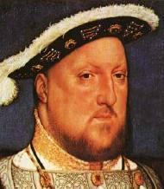
ENGLISH
REFORMATION
Created by Lisa Sydeski
Thomas Jefferson High School

Slide 2
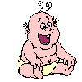
CAUSES – ENGLISH REFORMATION
RELIGIOUS DISPUTES
ECONOMIC/POLITICAL GAIN
PERSONAL/EMOTIONAL

Slide 3
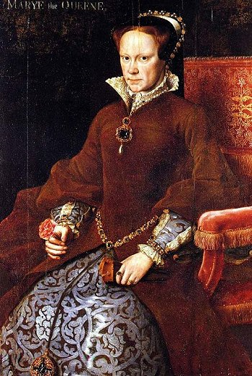
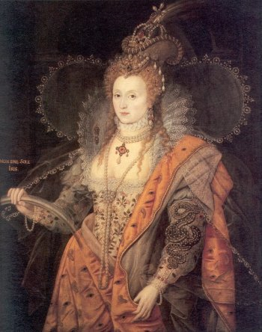
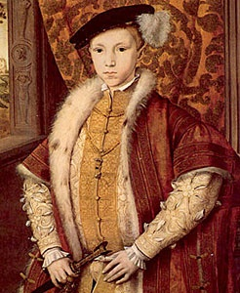
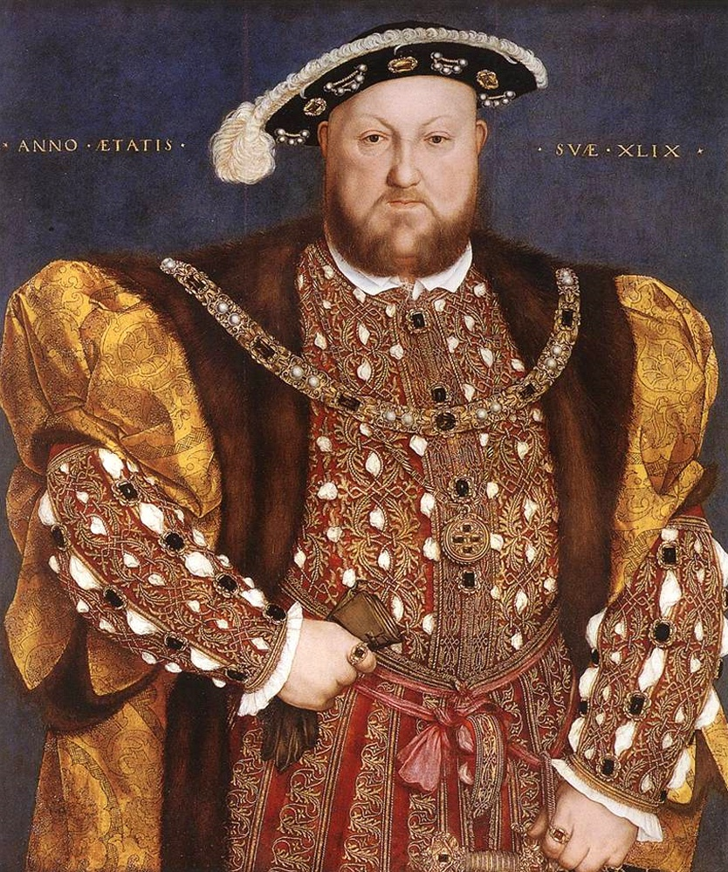
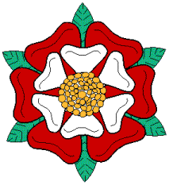
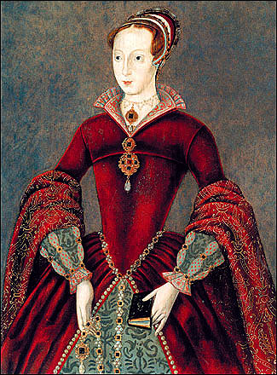
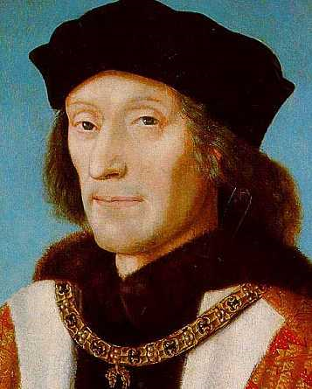
THE TUDORS (1485-1603)
HENRY VII (1485-1509)
HENRY VIII (1509-1547)
EDWARD VI (1547-1553)
Lady Jane Grey (1554)
MARY I (1553-1558)
ELIZABETH I (1558-1603)

Slide 4
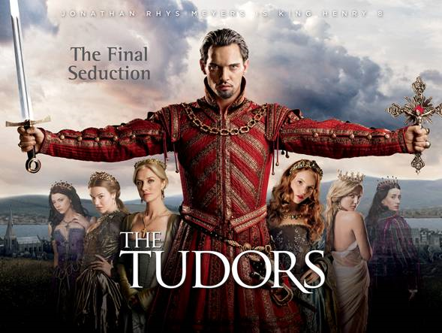

Slide 5
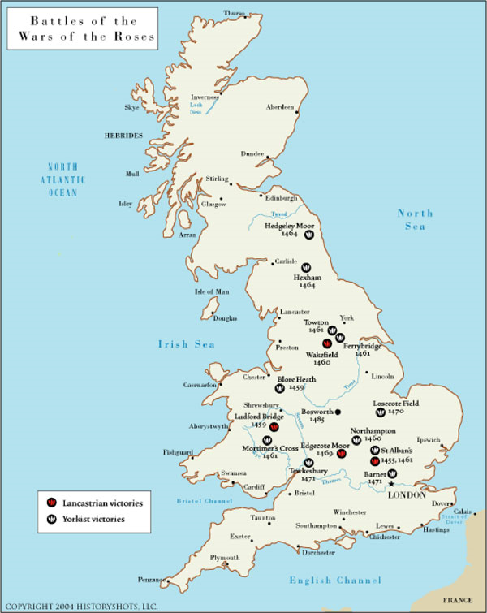
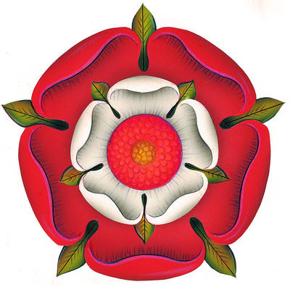
HENRY VII
Founder of the Dynasty
War of the Roses (1455-1485)
Lancaster (Henry VII) vs. York (Elizabeth)
Maintained Peace
Stability and Order

Slide 6
HENRY VIII
“New Monarch”
Divorce – “The Matter”
6 Years
Series of Legislation - Act of Supremacy (1534) “Head of the Church and State”
Six Wives

Slide 7
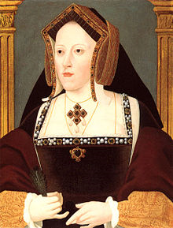
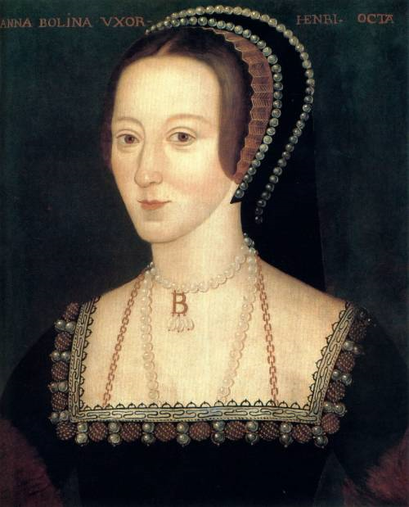
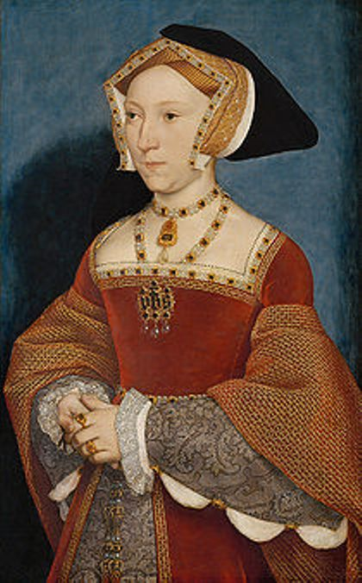
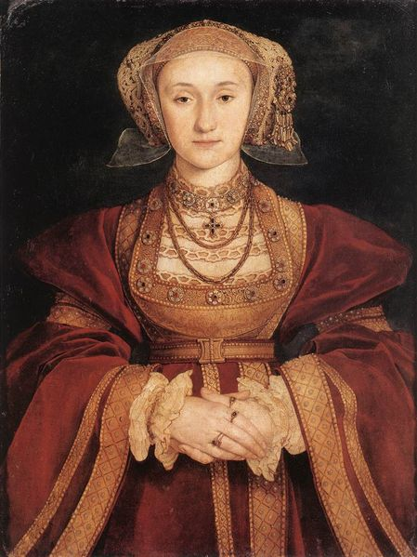
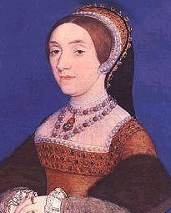
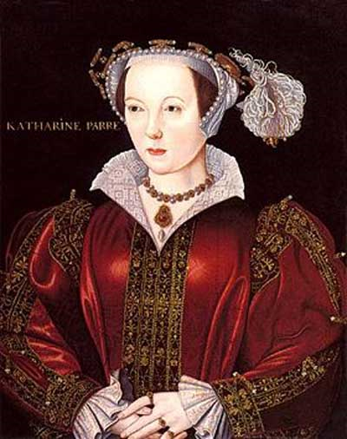
Wives of HENRY VIII
Divorced
Beheaded
Died
Divorced
Beheaded
Survived

Slide 8
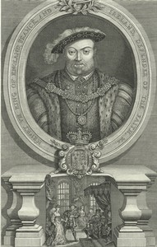
PRIOR TO THE BREAK
Henry VIII – Catholic
1521 – Defense of the Seven Sacraments – against Luther
Pope Leo X (1515-1521)– “Defender of the Faith”

Slide 9
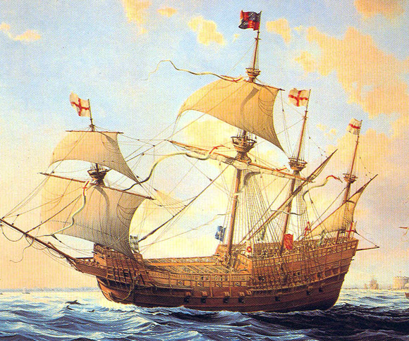
Legacy of HENRY VIII
Laid the foundation for the MODERN NATION STATE
Centralized Power
Dissolved the Monasteries / Sold Land
Controlled Nobility / Church
Executed those who opposed – Treason
Sir Thomas More (1475 -1535)
1st Battle ship – Mary Rose (1545)

Slide 10
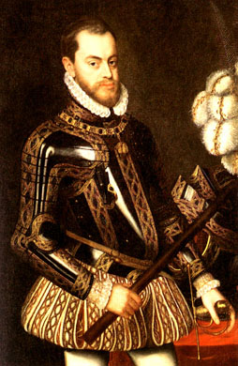
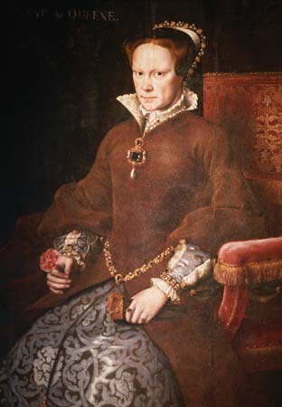
MARY I
(r. 1553-1558)
Daughter of Henry VIII & Catherine of Aragon
Devout Catholic
Married Philip II (Spain) 1555
“Bloody Mary”
Burned 300 Protestants

Slide 11
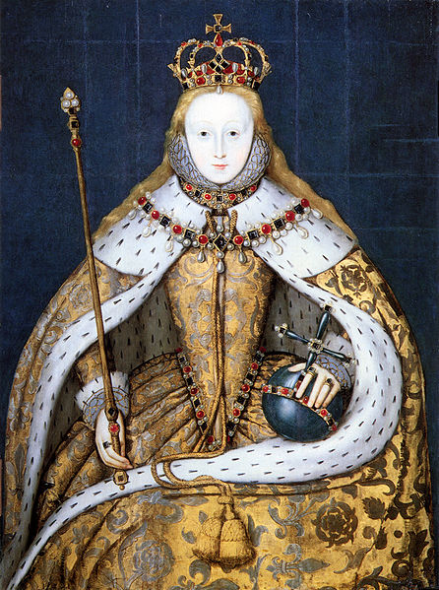
ELIZABETH I
(r. 1558-1603)
Daughter of Henry VIII and Anne Boleyn
“I may not be a lion, but I am a lion’s cub, and I have a lion’s heart”
“Virgin Queen”
The Last TUDOR

Slide 12
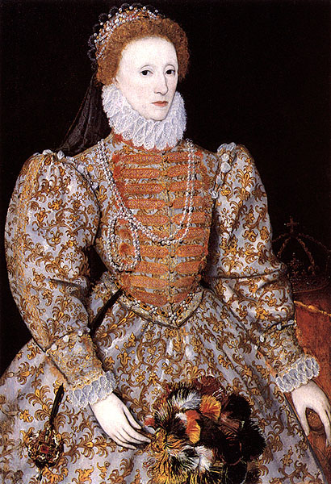
ELIZABETH I
ABSOLUTISM????
Politique
Parliament – Legislation
Religious upheaval – 30 years
RELIGIOUS UNITY = POLITICAL UNITY
ANGLICAN CHURCH

Slide 13
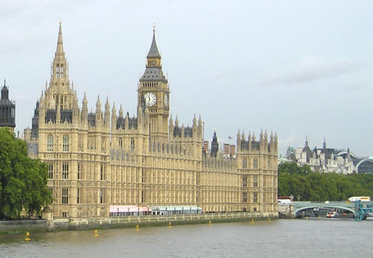
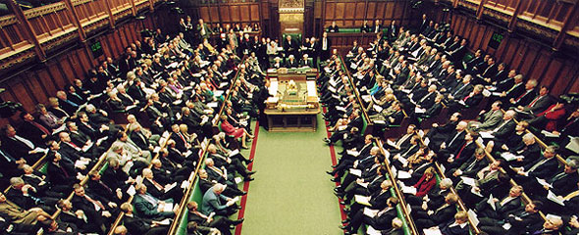
PARLIAMENT
“Great Council”
Evolutionary Process
Bi-Cameral Legislature
House of Lords
House of Commons

Slide 14
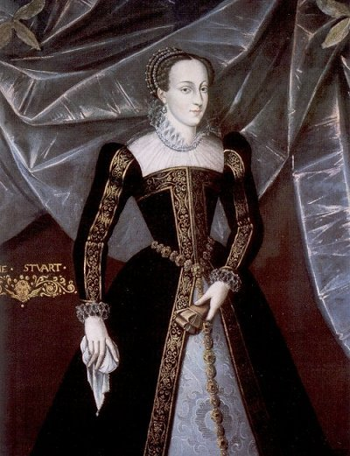
MARY QUEEN OF SCOTS
(1542-1587)
Stuart
Cousin of Elizabeth I
Queen of Scotland (1542-1567)
Catholic = heir to the throne
Imprisoned 19 years
Beheaded

